Slide 1
Advanced Regression
Overview
© Explore Data Science Academy

Slide 2


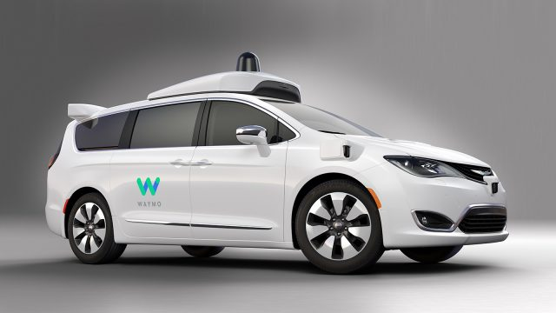
What is Machine Learning?
Machine learning is the study of software that automatically learns from experience.
Types of machine learning
Where is it used?
Supervised
Given sets of input-output pairs (x’s and y’s), the algorithm finds hidden relationships in the data (function approximation)
Prediction / Classification
Credit & Insurance underwriting
Cancer detection
Speech recognition
1
Unsupervised
Given input data only, the algorithm identifies clusters, patterns and anomalies in the data.
Clustering / Grouping
Recommendation systems
Fraud Detection
2
Reinforcement
Given an environment and a reward function, the algorithm optimises its actions to maximise its reward.
Self-driving Cars
Autonomous Robots
Utilities (traffic management)
Game Playing
3

Slide 3
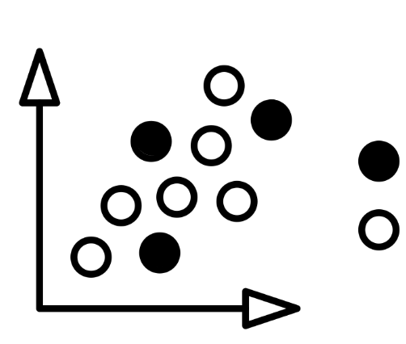
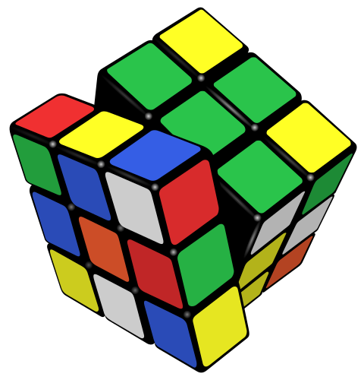



Machine Learning in Practice
Preprocessing
Model Building
Model Evaluation
Deployment
Test set
Training set
Data Cleaning
Impute
Normalise/Standardise
Label/Dummy encode
Train-Test split / Kfold
Model Selection
Model Training
Hyperparameter Tuning
Evaluate Model on Test set
Report Performance metrics
Hosting and Versioning
Dashboards
Containerization
Docker
Kubernetes

Slide 4
Things to consider - the larger AI spectrum
Artificial Intelligence is the broad term used to describe machines with cognitive ability.
Artificial Intelligence
Deduction, Reasoning, Problem Solving
Computer Vision
Robotics and Automation
Expert Systems
Machine Learning
Natural Language Processing
Intelligent Visuals and Knowledge Representation
Supervised Learning
Unsupervised Learning
Reinforcement Learning

Slide 5

Introduction to regression
Regression is finding relationships between:
A numeric, dependent variable Y
Like the price of a house, size of a loan, etc.
And, a number of independent predictor variables, each known as an X_{j}
Like the size and location of the house, type of tree, etc.
It’s a type of supervised learning:
Supervised learning is a subset of machine learning - simply the process of working out how some inputs relate to some outputs.
Inputs: independent X_{j}’s described above;
Outputs: dependent Y, as above.
X_{j}
Y
Area | Location
43 | Sandton
87 | Clifton
. | .
. | .
Price
R16m
R22m
.
.
SOME
RELATIONSHIP

Slide 6
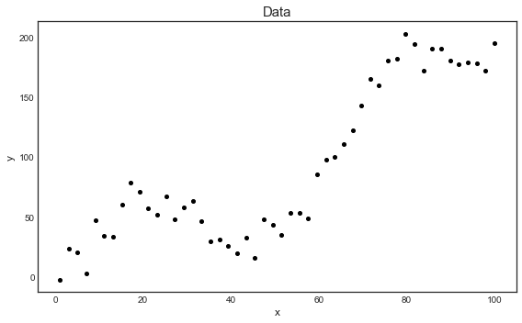
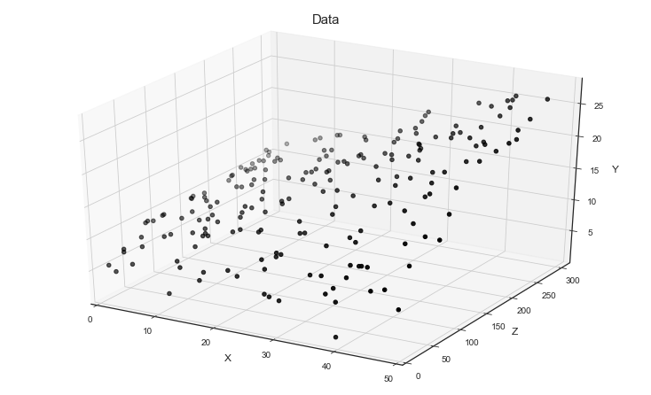
Introduction to regression (continued)
Our data is some mystery function y = f(X):
We will never know what the true f is.
Machine learning is the process of getting as close as we can to that f.
The gap between the true f and our approximation of it is known as error.
The model we produce is ŷ = f(X) + error.
We have means of determining how close our ŷ is to f - called goodness of fit measures.
Regression is useful for:
Modelling and analysing data;
Explaining relationships between variables (the X_{j}s);
Predicting numerical values.
Here is one example of a function
y = f(X)...
...and another. Can we find some ŷ that closely models them?

Slide 7
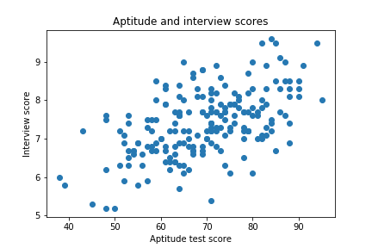
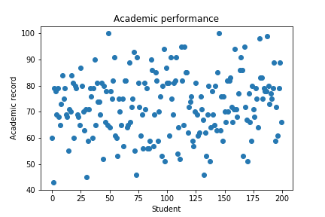
Simulated aptitude and interview scores, and academic performance

Slide 8
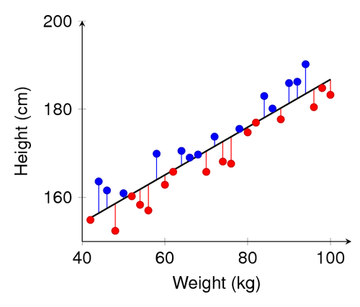
Linear regression mechanics
The vertical blue and red lines are the residuals.
Linear regression:
Is the process of fitting a straight line through the data.
Known as the line of best fit.
How is the line fit?
Method known as ordinary least squares (OLS);
Residuals: vertical distances between the line we fit and the data points we have (see right).
OLS attempts to minimise the residuals to fit the line.
Common measures of fit:
Mean squared error (MSE);
R² (quality of fit).

Slide 9
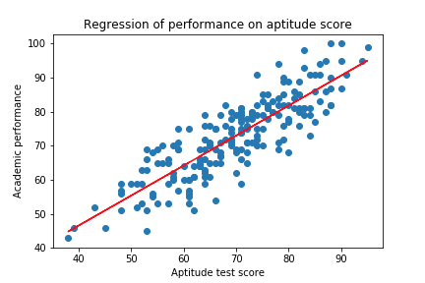
Univariate regression 1: On aptitude test score
Univariate means that we only have one predictor variable (one X_{j}).
Here are some measures of fit:
Mean squared error and
R-squared
MSE: 37.12
R²: 0.731

Slide 10
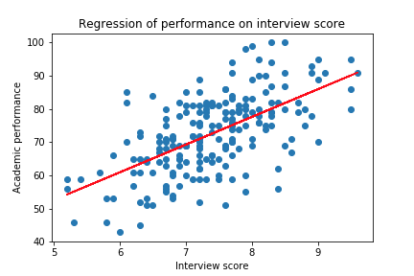
Univariate regression 2: On interview score
MSE: 87.42
R²: 0.366

Slide 11
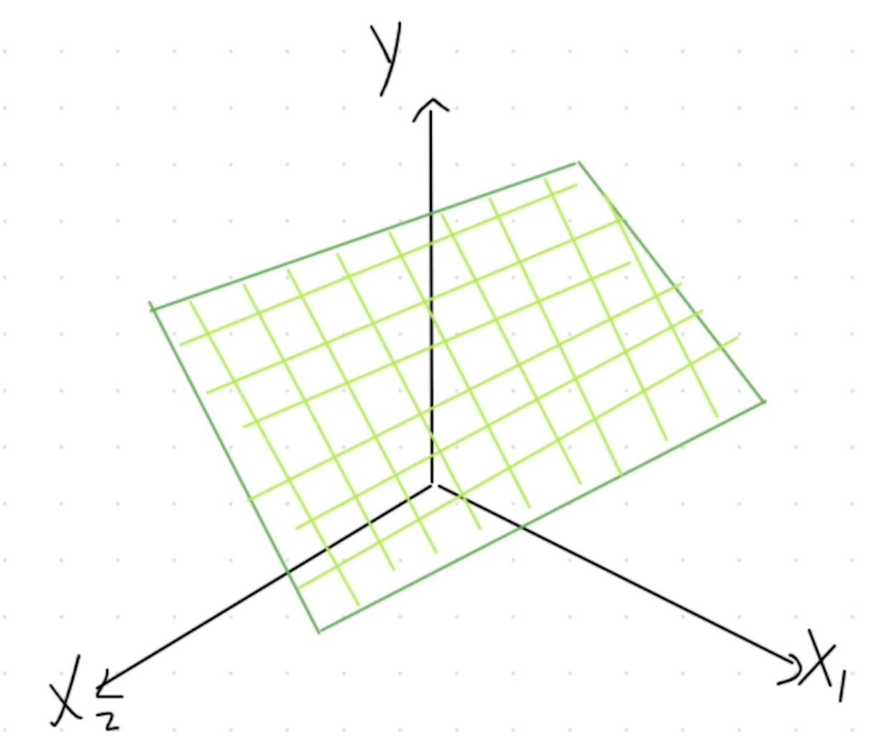
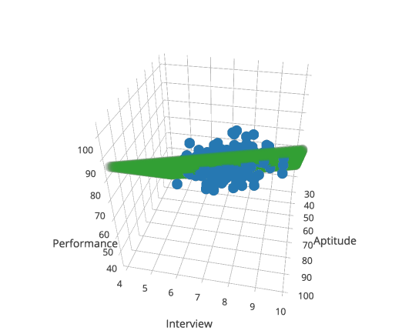
Multiple linear regression: On aptitude & interview scores
Multivariate means we have multiple predictor variables (multiple X_{j}s).
MSE: 33.165
R²: 0.756
With one variable, we had a straight line.
With 2+ variables, we get a flat plane (known as a hyperplane).

Slide 12
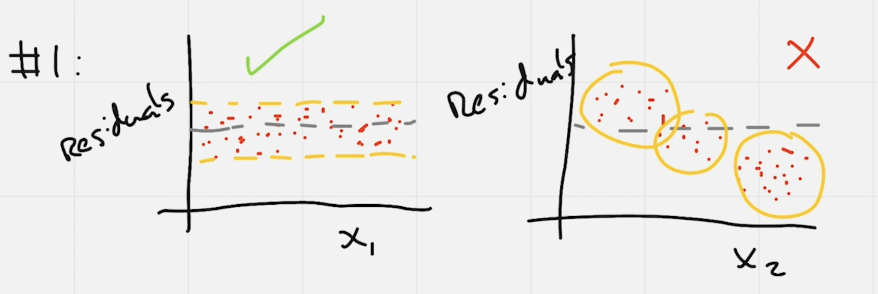
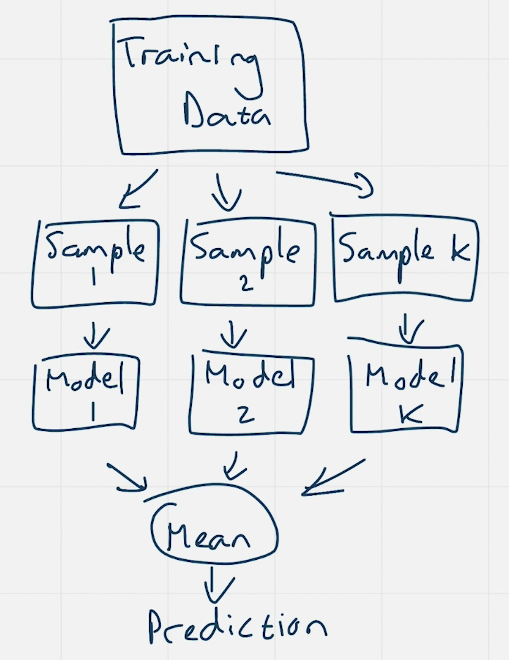
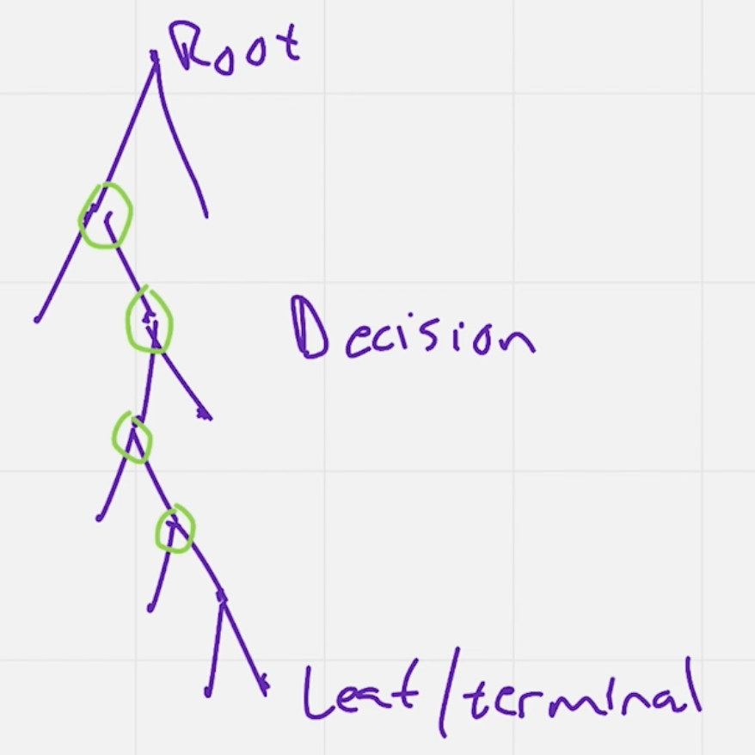
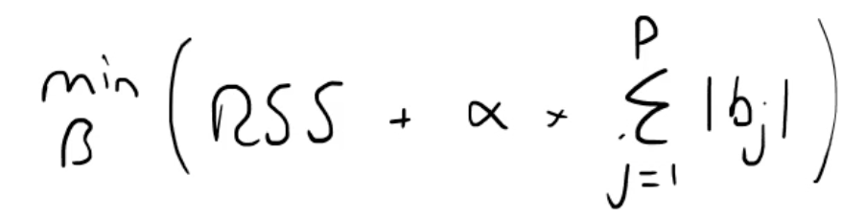
Model selection problems
We’ll learn about ways to solve the following problems:
Model overfitting - occurs when we have a large number of predictor variables (X_{j}s) compared to the number of data points.
Collinearity - when the predictor variables (X_{j}s) are correlated to one another.
Model interpretability - can we actually explain the model to someone, given that it has so many parameters?
Assuming the wrong shape of f - there are many alternatives to linear regression, including random forests, support vector machines, decision trees, among others.

Slide 13
Your EGAD Regression Sprint Heatmap
Explain
Gather
Analyse
Deploy
DRAFT
Problem Statement
Problem Landscape
Equation of Value
Project Management
DO
Story Telling
Databases
Programming
Version Control
DELIVER
Communication
Data Engineering
Solution Governance
Production
DECOMPRESS
Feedback
Insights
Performance Metrics
Maintenance

